Slide 1
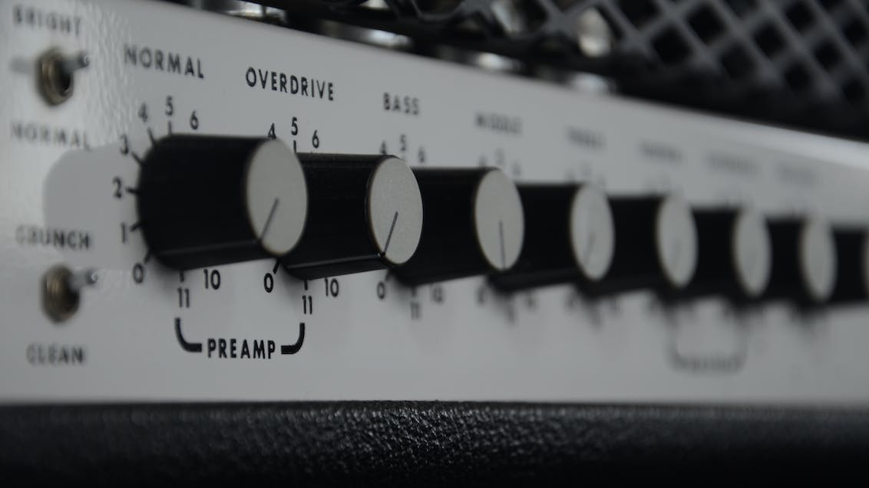
HIGH frequency amplifier
Analog Mates

Slide 2

Objective
Bandwidth: 20kHz – 100kHz
Minimum number of transistors used: 3
Operating Voltage< 12V
Input: 100mV peak to peak
should be able to drive 8 Ω (headphone) load without significant waveform distortion or amplitude reduction.

Slide 3
There are 6 main parameters in the specification of the product:
1. Open circuit gain
2. Gain with the 8Ω load
3. Bandwidth
4. Input Resistance
5. Output Resistance
6. Power Dissipation

Slide 4
Flow of the Circuit
Input
Stage 1 Pre-Amplifier
Stage 2 Power Amplifier
Output

Slide 5
Stages of the amplifier:
Pre Amplifier:
We use a common emitter bjt amplifier with the potential divider biasing technique (This is a class A type amplifier)
Power Amplifier:
We use the push-pull amplifier with 2 emitter followed voltage buffers (This is a class AB amplifier)

Slide 6
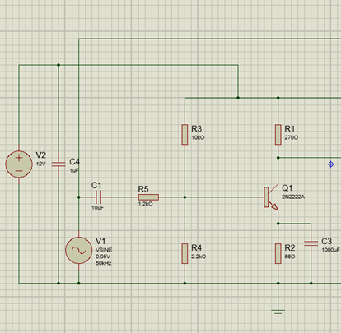
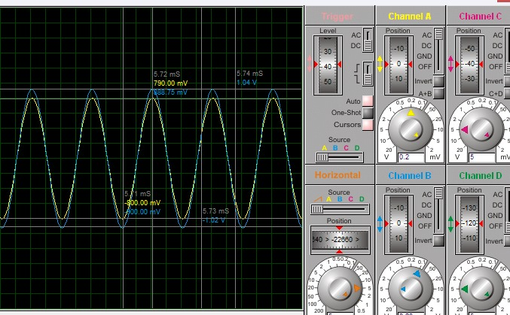
1.PRE- Amplifier
This is a class A simple common emitter BJT amplifier. We obtained an approximate voltage gain of 20.

Slide 7
Solution
Problem??
Use the class AB type push-pull amplifier to protect the gain value.
This circuit can protect the voltage gain using voltage buffer common collector BJT amplifiers.
Then we can get a reasonable gain even after the load is connected.
Gain decreases when the load is connected.
That means the power amplification of the circuit is not better.

Slide 8
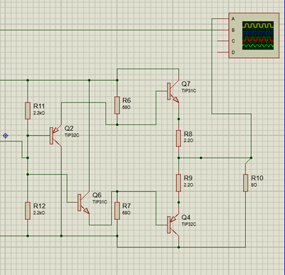
2.Power Amplifier
The AB Push Pull stage serves as the amplifier's second stage.
Its purpose is to achieve the required power amplification to drive an 8-ohm load (speaker) while minimizing any substantial reduction in the output amplitude.

Slide 9
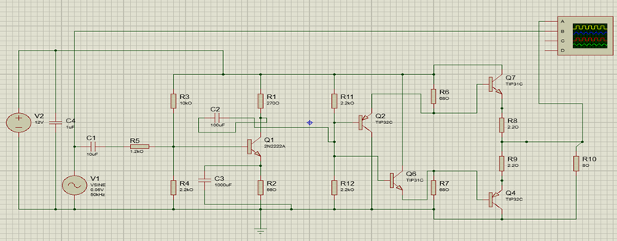
Prototype Design

Slide 10
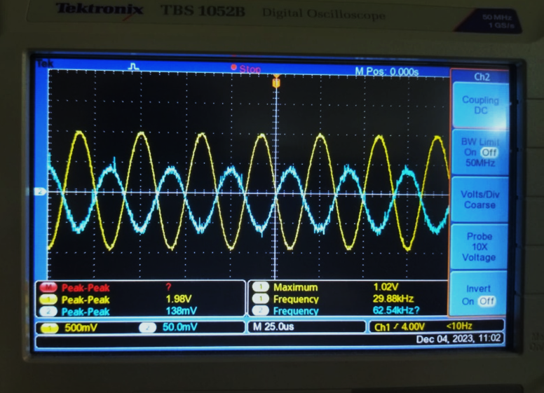
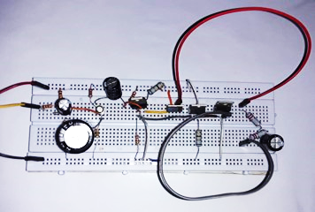
Output waveform with 8Ω load
Breadboard
Implementation

Slide 11

Components used in the circuit:
2N2222A NPN BJT transistor
TIP 31C power transistor (2)
TIP 32C power transistor (2)
Capacitors (1µF, 10 µF, 100 µF, 1000 µF, 220 µF)
Resistors (1.2kΩ, 10kΩ, 2.2kΩ, 270 Ω, 56 Ω, 2.2k Ω)
Power resistors (68 Ω, 2.2 Ω)

Slide 12
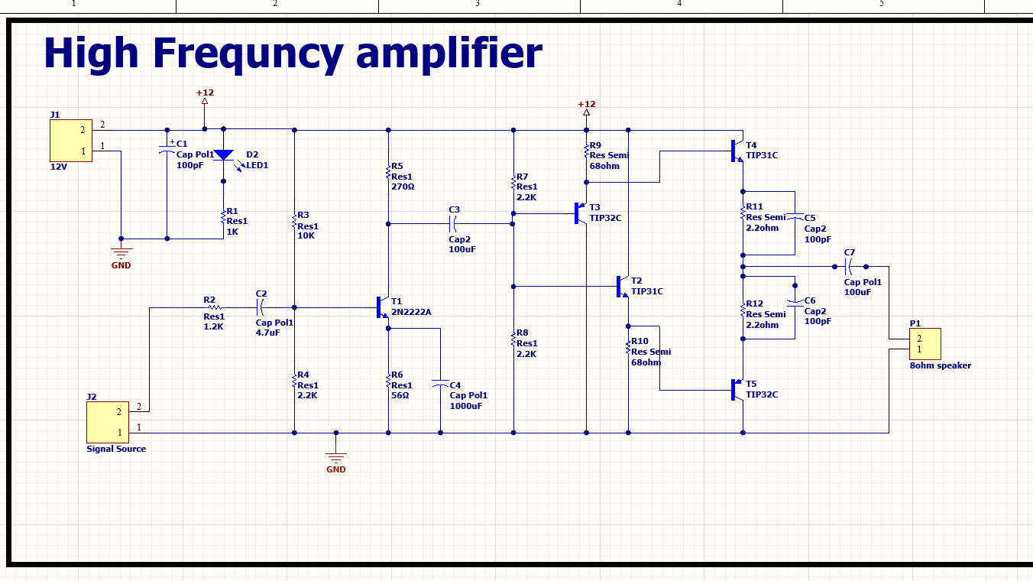
Circuit Diagram

Slide 13
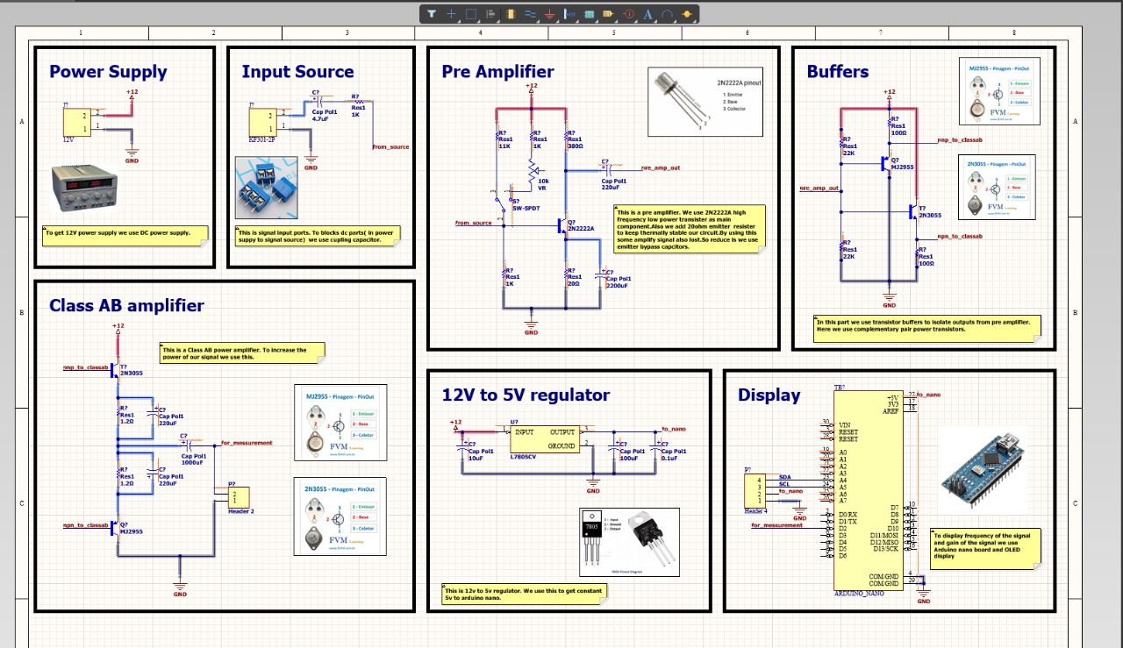
PCB Schematic Diagram

Slide 14
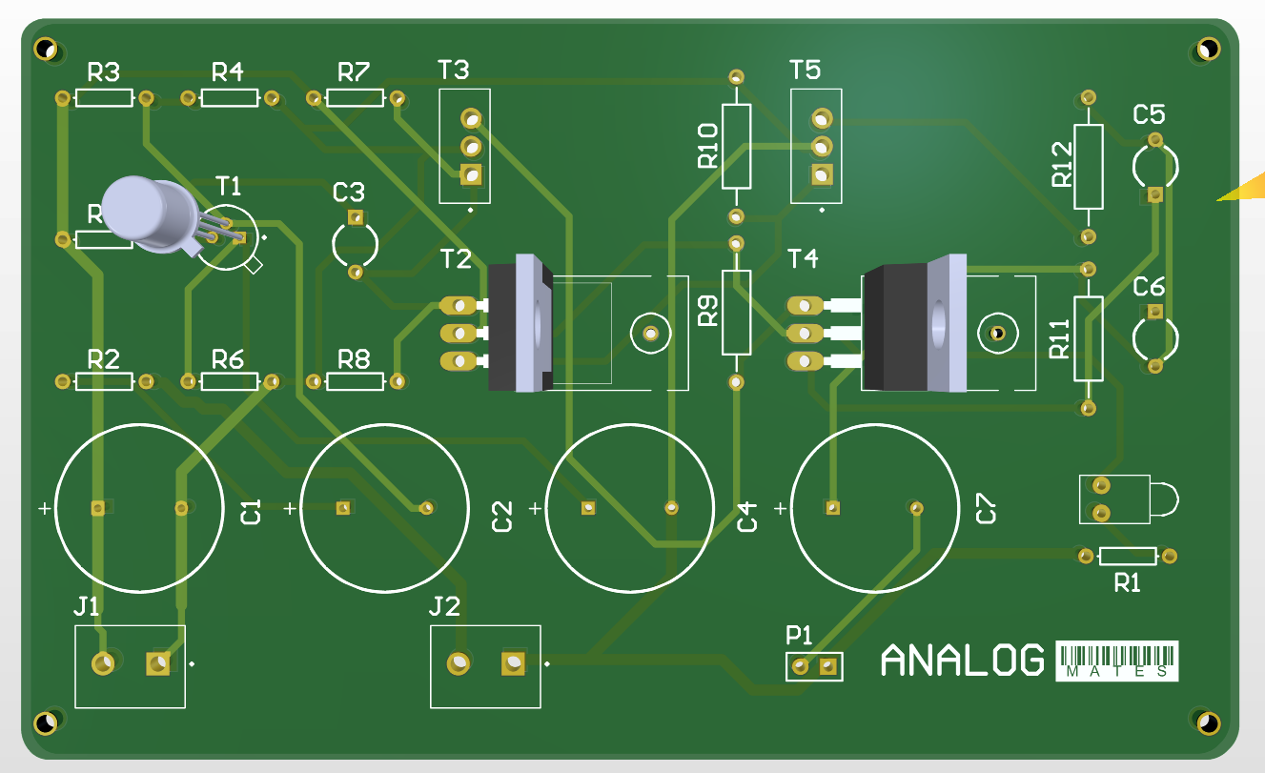
PCB Implementation

Slide 15
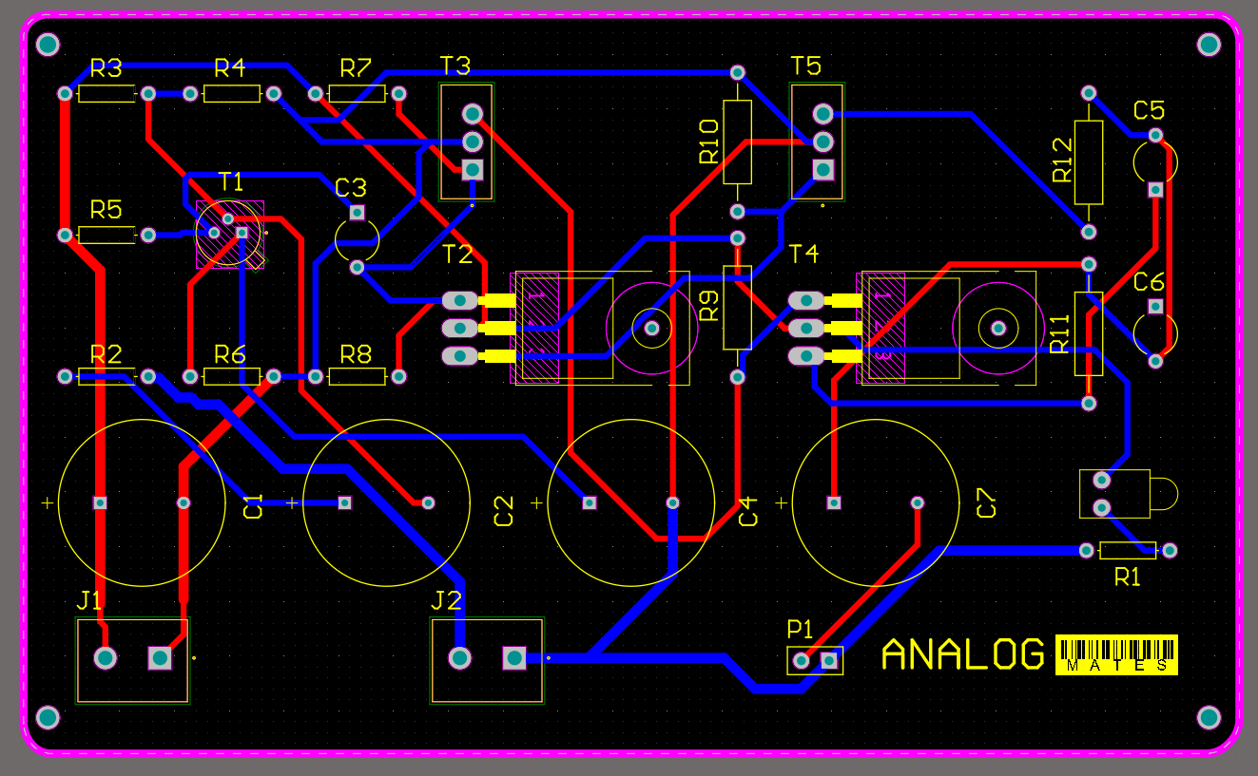

Slide 16
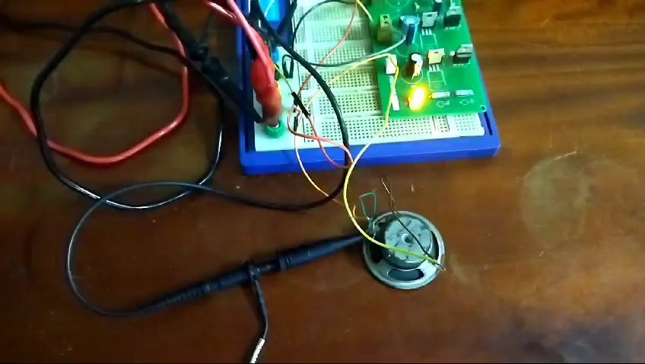
Testing with the PCB

Slide 17
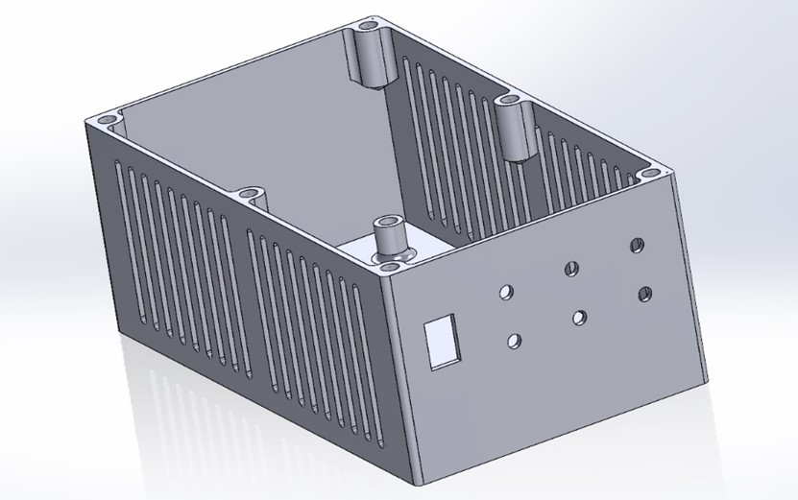
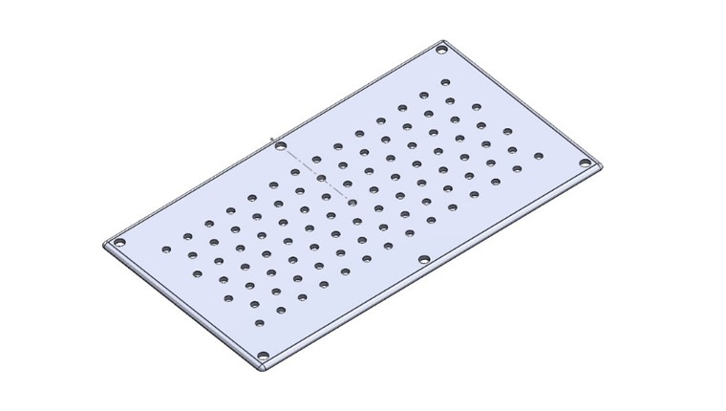
Enclosure Design
SolidWorks Sketches

Slide 18
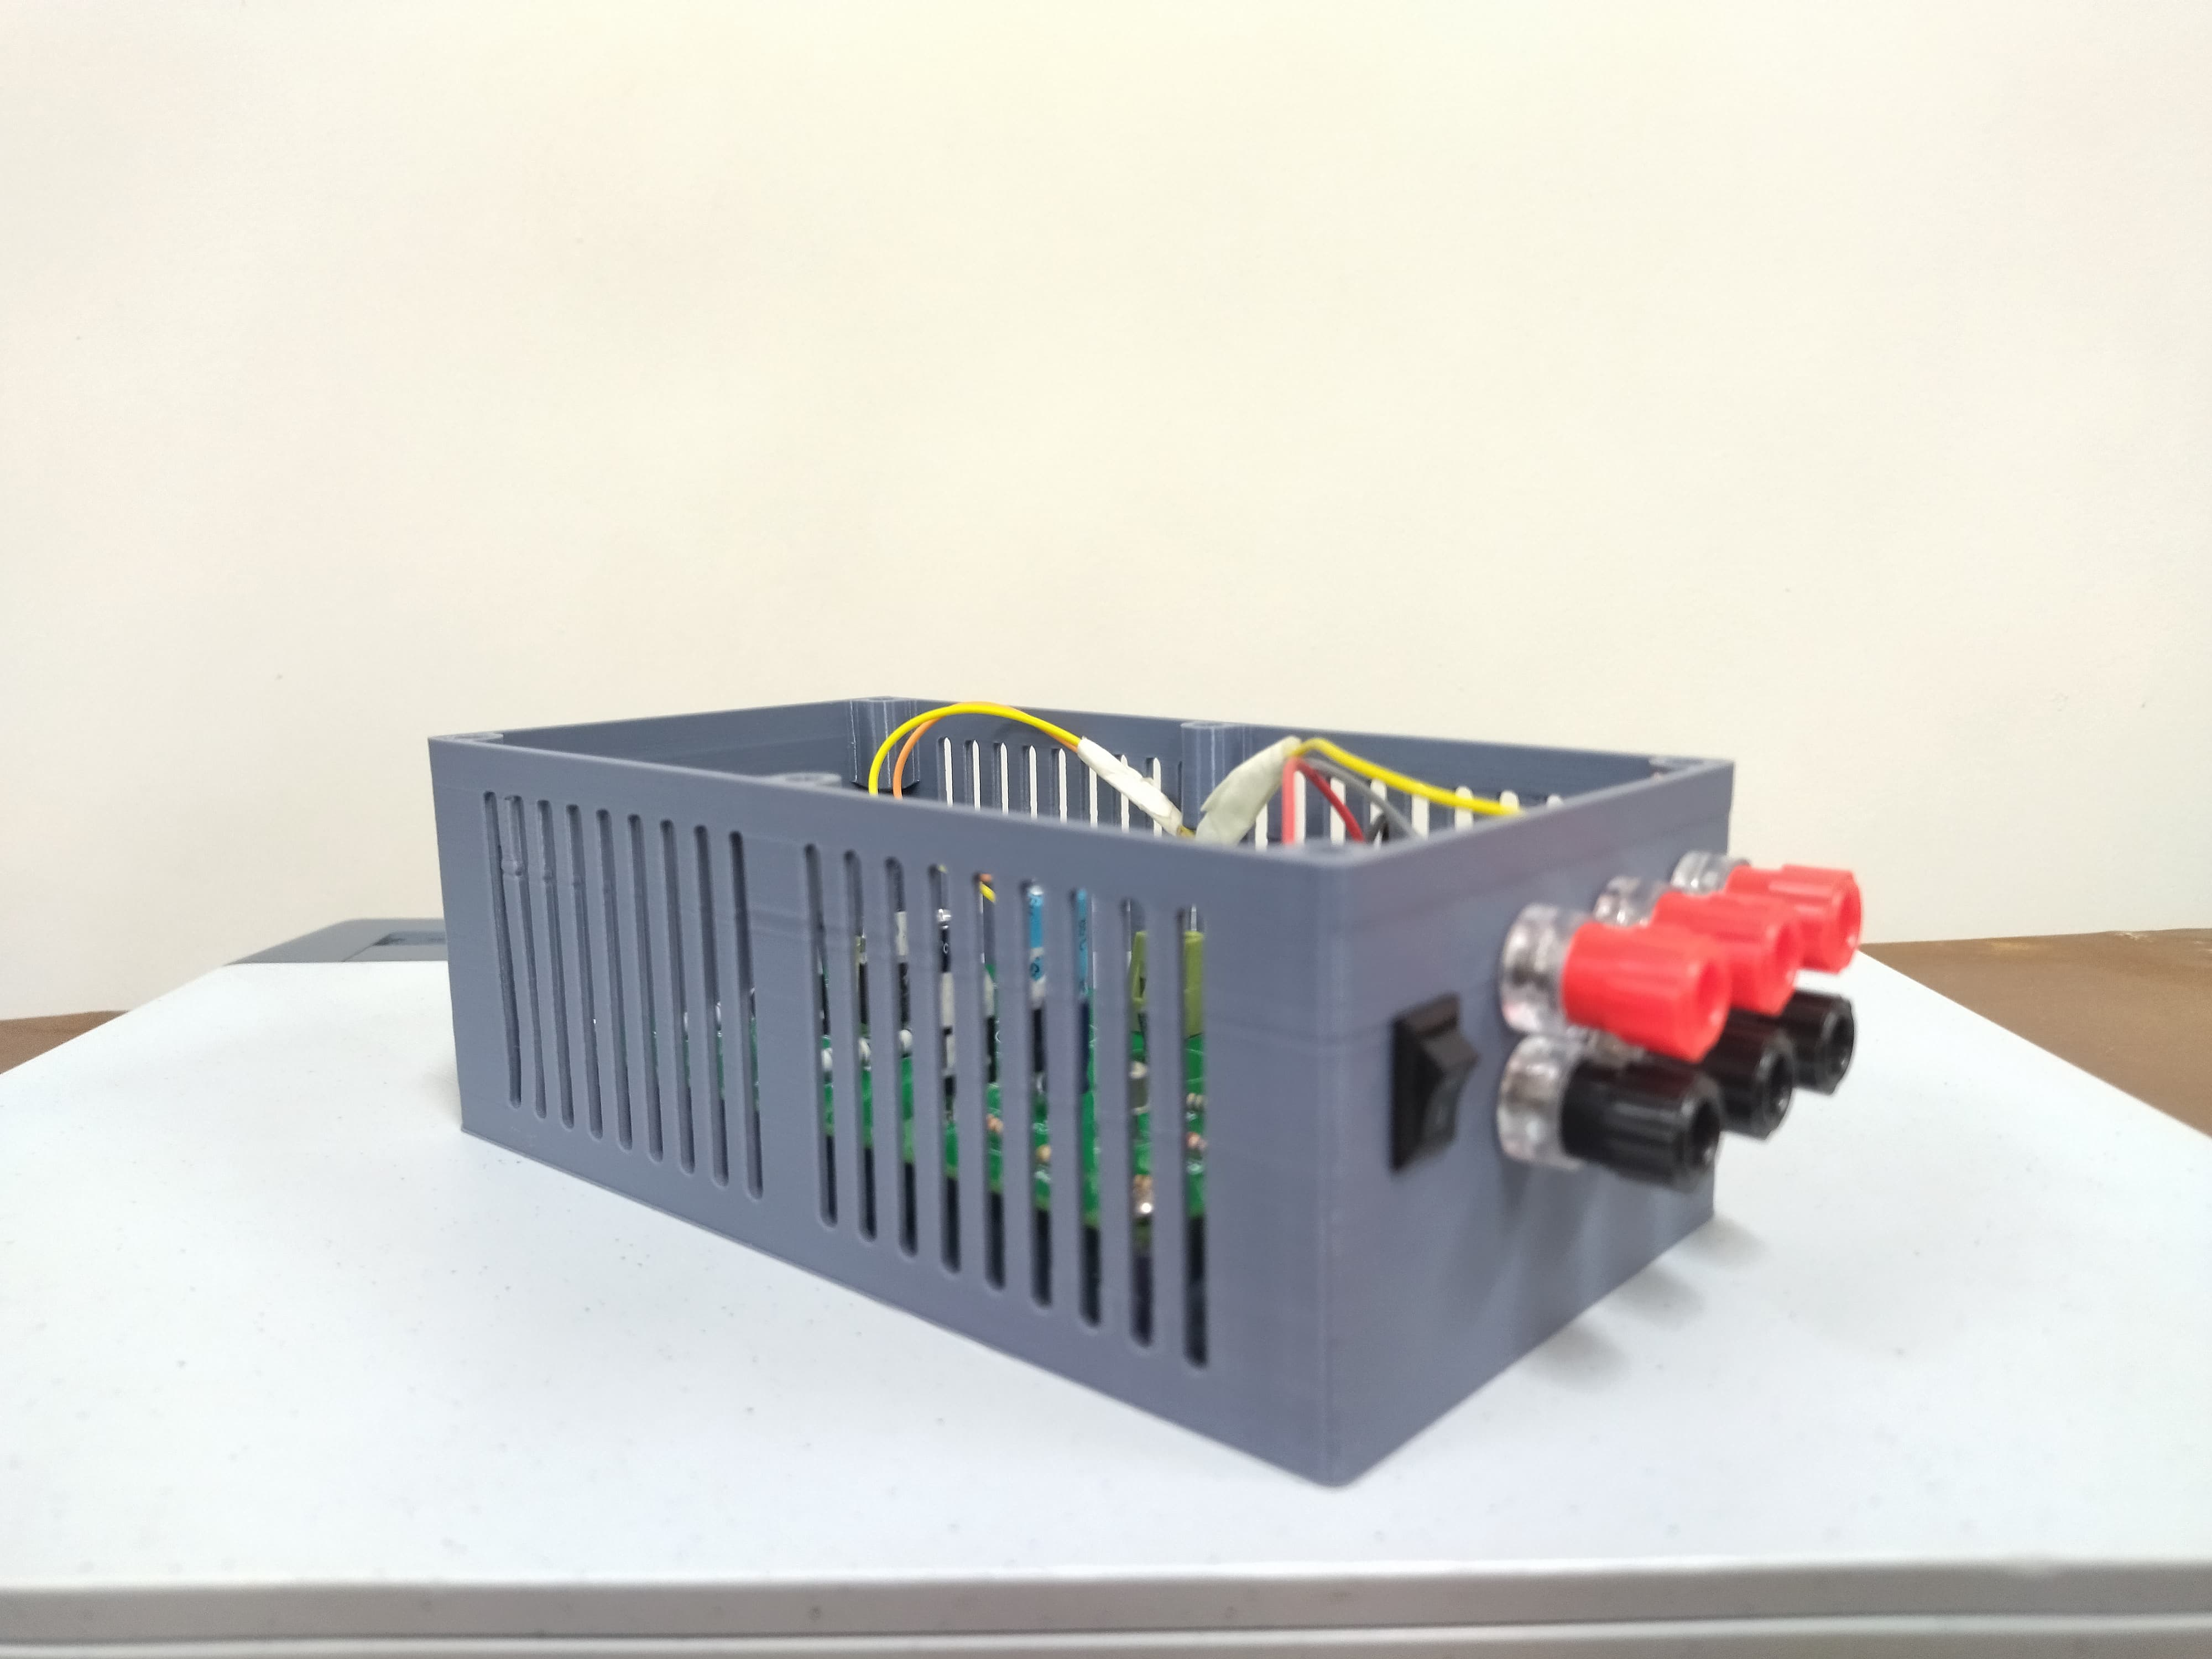
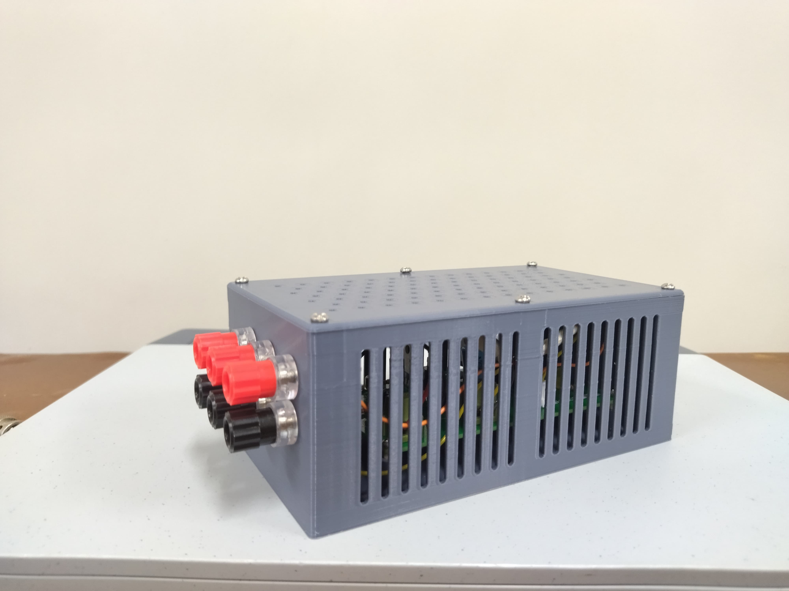
Final Product

Slide 19
Individual Contributions
Maduwantha L.H.H - 200370K
PCB design, Component Selection
Dimagi D.H.P. – 210131N
Enclosure design, Breadboard Implementation
Circuit design, Simulation in Proteus
Dissanayaka D.M.P.C. – 210140P
Enclosure design, Soldering PCB, Breadboard Implementation
Dilshan N.L. – 210129P

Slide 20


Thank you!

